Slide 1

Pathogen Reduction of Blood and Blood Components
A Regulator’s Perspective
Carlos H. Villa, MD PhD
Associate Director for Special Programs, Office of Blood Research and Review
Center for Biologics Evaluation and Research, U.S. Food and Drug Administration
Silver Spring, Maryland, USA
May 10, 2023 – Bologna, Italy

Slide 2
Conflicts of Interest
I have no conflicts of interest to declare.

Slide 3
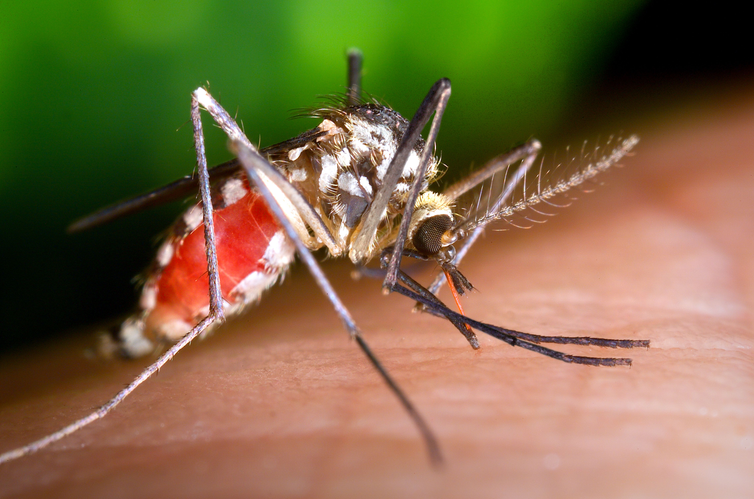
Transfusion Transmitted Infections (TTIs)
While rare, TTIs remain among the most significant potential complications of blood transfusion, and risks persist despite advances in donor screening and testing
Donor screening and testing are subject to limitations
  Test sensitivity
  Test development
  Logistic complexity
  Cost
  Potential deferral of otherwise eligible donors
Emerging or novel pathogens are a significant challenge

Slide 4

FDA’s Approach to Blood Safety
Consists of multi-layered protections for donated blood
  Donor education and screening
  Donation testing
  Donor deferral lists
  Quarantine, recall, and lookback
  Problems and deficiencies

Slide 5
A new layer:
Pathogen Reduction Technology (PRT)
PRT can inactivate pathogens to reduce the risk of TTIs
PR devices have historically been designed to target nucleic acids
  Rationale: platelets, plasma, and RBCs do not rely on nucleic acids to be viable/effective, but pathogens will be unable to replicate
Alternative approaches used in manufacture of blood derivatives, such as solvent/detergent treatment, may not be
viable candidates for cellular components of blood

Slide 6
Current Status of Pathogen Reduction for Blood Components
Examples of technologies investigated to date:
  Amotosalen/UVA (INTERCEPT System for Plasma and Platelets) [approved in US]
  Amustaline/S-303 (INTERCEPT System for RBCs)
  Riboflavin/UVA/UVB (Mirasol)
  UVC (THERAFLEX UV-Platelets)
  Methylene blue/visible light (THERAFLEX MB-Plasma)
PR technologies subject to certain limitations
  Inadequate inactivation of certain pathogens
  Applicability to only certain components
  Potential adverse effects on quality of components
  Complexity/cost of implementation
Marks, P. and Verdun, N. (2019), Toward universal pathogen reduction of the blood supply (Conference Report, p. 3002). Transfusion, 59: 3026-3028. https://doi.org/10.1111/trf.15410

Slide 7
Targeting Nucleic Acid as an Approach to PR
Small molecules are not perfectly selective for nucleic acid binding/reactivity, so there is off-target damage (e.g., generation of ROS with photochemical approaches)
Nucleic acids may have a role in normal physiology of RBCs and platelets, so nucleic acid targeting may impact component quality
Nucleic acid targeting is not specific to pathogens alone, so may need additional safety measures to off-set potential
genotoxicity (e.g., quenching, adsorption)
Some pathogens may be resistant

Slide 8
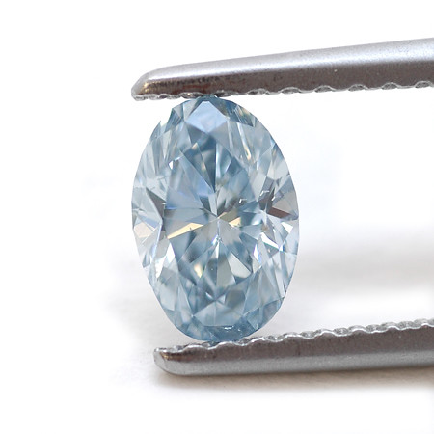
The Ideal PRT
Inactivate known pathogens by at least several orders of magnitude (e.g., >5 log)
  Provide a safety margin for unknown pathogens
Poses no increase in carcinogenic, immunogenic, or reactogenic risk
Can be performed on whole blood up-front and allow separation into components (plasma, platelets, RBCs) with retained function
No need for major capital equipment, applied easily to whole blood or apheresis donations
Eliminates need for leukoreduction and irradiation
Cost sufficiently modest that with reduction of testing for certain pathogens, it is cost-neutral or cost-advantageous
"Fancy Intense Blue, Oval Diamond by Leibish & Co" by FancyDiamonds.net is licensed under CC BY 2.0.
Marks, P. and Verdun, N. (2019), Toward universal pathogen reduction of the blood supply (Conference Report, p. 3002). Transfusion, 59: 3026-3028. https://doi.org/10.1111/trf.15410

Slide 9
PR of Whole Blood (WB)
WB presents several challenges:
  Limited light penetrance is a challenge for photosensitization approaches
  Must be rapid and inexpensive to facilitate further manufacture into components
  Each component may be differentially sensitive to the intended approach
As with all PRT, the central challenge is achieving large enough inactivation to prevent disease transmission (e.g., >5 log) while preserving quality of subsequent components
pathogen inactivation
component quality

Slide 10
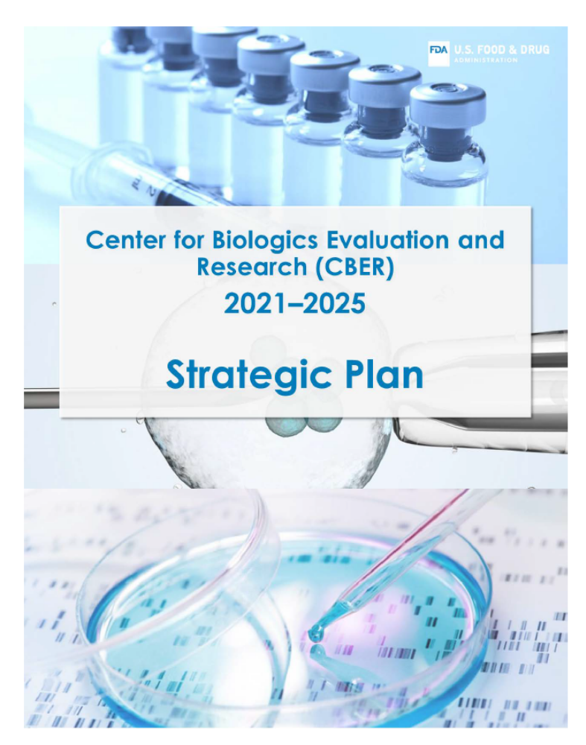
FDA Initiatives in PRT
In order to proactively address public health challenges and emerging infectious diseases, CBER identified development and facilitation of application of novel technology toward universal PRT of the blood supply as a key strategy
Through investments in intramural and extramural research, CBER is evaluating the ability of technology to inactivate a range of pathogens and the functionality of blood components after exposure to PRT

Slide 11
FDA Initiatives to Advance PRT
FDA hosted a public workshop on PRT for blood safety in 2018
  https://www.ncbi.nlm.nih.gov/pmc/articles/PMC6726584/
  Atreya, et al., Transfusion. 2019 Sep; 59(9): 3002–3025.
Broad Agency Announcement
  FDA funds extramural research through an agency-wide Broad Agency Announcement (BAA) for research and development to support regulatory science and innovation
OBRR has established an intramural pathogen reduction research program that conducts collaborative research to advance promising candidate technologies
  Includes development of model systems to measure
  component quality and inactivation of various pathogen types

Slide 12
Areas of Potential Research
Improve/optimize existing technologies
  Make current approaches more potent or selective
  Mitigate damage to blood components
Adapt related technologies to improve PR of WB
  E.g., apheresis instrumentation
Develop new technologies
  Entirely new approaches?

Slide 13
Device Paradigm
Following device pre-market approval (PMA), devices can be marketed for use by blood establishments in manufacture of blood components for transfusion
  Class III devices subject to PMA
  May require clinical studies to support approval of the device
  Blood establishments can then submit
  for licensure of the components manufactured
  using the FDA-approved device

Slide 14
Regulatory Challenges in PR
While several in vitro models quantitatively measure inactivation of pathogens (‘log reduction’), this is not a direct measure of prevention of infection transmission
Level of inactivation necessary to prevent infection transmission is uncertain and difficult to study in a clinical setting
  Interpretation typically relies on multivariable models to predict the probability of transmission
  Likely to be pathogen dependent
  AIMS study demonstrated that PR (Mirasol) can reduce the transmission of malaria (https://pubmed.ncbi.nlm.nih.gov/27116282/)
Necessity for continued donor screening (eligibility or testing), which has proven safety for multiple pathogens, needs to be considered on a case-by-case (or pathogen-by-pathogen) basis

Slide 15
Examples of PRT as an alternative to donation testing or donor deferral
Bacteria: Platelets treated with FDA approved pathogen reduction devices according to the device instructions for use need no further measures to control bacterial risk (https://www.fda.gov/media/123448/download)
Malaria: FDA allows blood establishments to collect platelet and/or plasma components from a donor who is a resident of a non-endemic country and who has traveled to or through a malaria endemic-area without a deferral period, provided the blood components are pathogen-reduced using an FDA-approved PR device effective against Plasmodium falciparum (https://www.fda.gov/media/163737/download)
Babesia: Pathogen reduction can be used as an alternative to testing or donor questions to reduce the risk of transfusion-transmitted babesiosis (https://www.fda.gov/media/114847/download)
Zika: Although Zika virus (ZIKV) is no longer considered a relevant TTI (https://www.fda.gov/media/148549/download ), when testing blood donations for ZIKV was required, as an alternative to testing, blood establishments could comply with regulatory requirements by using an FDA-approved pathogen reduction device

Slide 16
Demonstrating Safety and Efficacy of Pathogen Reduced Blood Components
The evidence needed to support pre-market approval of a PR device is based on FDA’s product-specific assessment of the benefits and risks
Evidence can come from multiple sources:
  In vitro pathogen reduction
  In vitro characterization of components
  Pre-clinical studies
  Recovery and circulatory survival studies
  Clinical trials

Slide 17
In vitro Pathogen Reduction
Measure pathogen reduction or inactivation of a range of relevant pathogens, including:
  Enveloped viruses
  Non-enveloped viruses
  Parasites/protozoa
  Gram positive bacteria
  Gram negative bacteria
  Certain other pathogens, as appropriate (e.g., anaerobes, spirochetes)
While a given technology may not inactivate all pathogens, a wide spectrum of activity should be demonstrated

Slide 18
In vitro characterization of blood components
Biochemical and physical properties
  E.g., morphology, electrolytes, ATP, 2,3DPG, lactate, hemolysis, surface markers
Functional activity
  Plasma: Coagulation factor (and anticoagulant) activity
  Platelets: Activation and aggregation
  Red cells: Oxygen dissociation
Product recovery/counts
Other markers of safety
  Biochemical tests of potential adverse effects
  (formation of immunogenic antigens)

Slide 19
Pre-clinical studies
Pharmacology and toxicology studies to support the safety of compounds and devices used in the PRT process and potential process impurities or byproducts
  Extractable and leachable studies of devices, where applicable
Animal models may also be used to
demonstrate component safety and efficacy

Slide 20
Radiolabeling and survival
Circulatory recovery and survival of cellular blood components (RBCs and platelets) are measured using standardized radiotracer (⁵¹Cr/¹¹¹In) methods
Examples:
  RBCs: recovery of more than 75% of infused cells at 24 hr post-infusion in healthy volunteers
  Platelets: recovery and survival criteria in comparison to fresh autologous control
  (e.g., 66% and 58% of control, respectively)

Slide 21
Clinical Studies
Well-controlled clinical trials can provide reasonable assurance that a PR device is safe and effective for its intended use or uses
The optimal clinical study design for blood and blood components may be variable
  Limitations to consider:
    Uncertainty on optimal endpoints for bleeding and anemia
    Clinical practice in transfusion medicine not always the result of well-controlled RCTs
  May consider non-inferiority designs compared to standard components
Example: Non-inferiority study of bleeding (proportion of patients with WHO Grade ≥2 bleeding) in thrombocytopenic patients receiving PR platelets compared to control (https://pubmed.ncbi.nlm.nih.gov/15138160/)

Slide 22
Final perspective
While certain aspects of component quality may be impaired, inactivation of pathogens can provide an additional layer of safety
Benefits and risks of a given PR approach will depend on context of use
PR may ultimately increase the availability of safe and effective blood products, and even reduce cost
  Increase donor eligibility
  Reduce/eliminate certain donor tests
  Address emerging threats

Slide 23
Thank you

